Slide 1
Segmentation of the Tibia Bone from MR Images using
Deep Convolutional Neural Networks U-net
CS631T-Computer Vision
Lecturer: Lixin Chen
Junbin Sun
Mentor: Professor Shan

Slide 2
Research Procedure
Introduction
Data Labeling
Model Training and Testing
Enlarge the Dataset and Train the Final Model
Result Analysis and Conclusion

Slide 3
1
Introduction

Slide 4
Research Procedure
Introduction
MRI is gradually replacing CT for bone and joint examination. Many diagnostic applications critically depend on the successful localization of bone structure. In this project, we have trained a machine learning model (a convolutional neural network called U-Net) to perform bone segmentation on 3D knee magnetic resonance imaging (MRI). The goal is to develop a method that can automatically detect the bone area from a knee MRI image.

Slide 5
Research Procedure
U-net
The U-Net is a convolutional neural network that was developed for biomedical image segmentation at the computer science department of the university of Freiburg, Germany.
The network is based on the fully convolutional network and its architecture was modified and extended to work with fewer training images and to yield more precise segmentations.
U-net is a semantic segmentation network based on FCN, which is suitable for segmentation of medical images.
Many split networks are based on FCNs for improvements, including Unet. Unet consists of two parts, you can see the picture, the first part, feature extraction, VGG is similar. The second part is the upsampling part. Since the network structure is U-shaped, it is called the Unet network.

Slide 6
Research Procedure
U-net
In the feature extraction part, there is a scale for each passing through a pooling layer, including the original image scale.
The upsampling part is fused once every time it is sampled, and the number of channels corresponding to the feature extraction part is the same, but it is cropped before the fusion. The fusion here is also stitching.

Slide 7
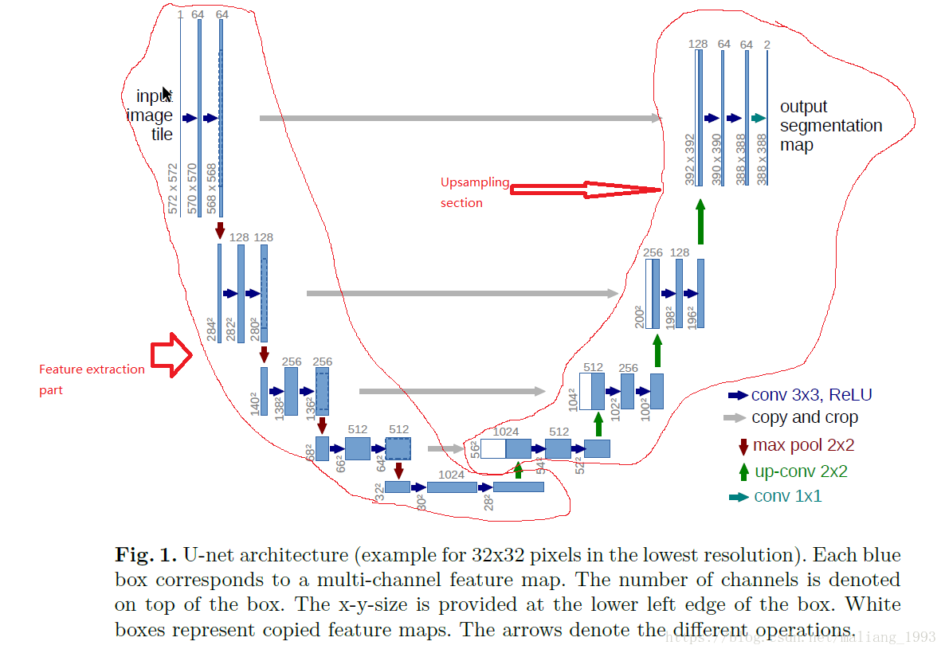
Research Procedure
U-net Structure
.

Slide 8
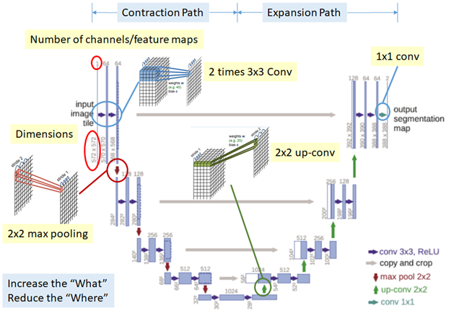
Research Procedure
It consists of contraction path and expansion path.
Contraction path :
Consecutive of two times of 3*3 Conv and 2*2 max pooling is done.
Expansion path :
Consecutive of 2*2 Up-conv and two times of 3*3 Conv is done to recover the size of segmentation map. However, the above process reduces the “where” though it increases the “what”.
That means, we can get advanced features, but we also loss the localization information.
Thus, after each up-conv, we also have concatenation of feature maps(gray arrows) that are with the same level.
This helps to give the localization information from contraction path to expansion path.
At the end, 1*1 conv to map the feature map size from 64 to 2 since the output feature map only have 2 classes, cell and membrane.
U-net Structure
.

Slide 9
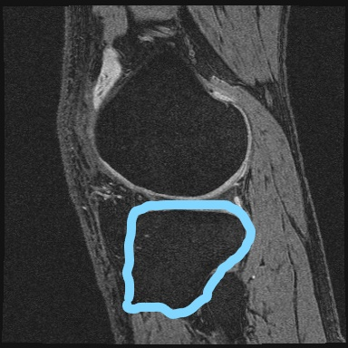
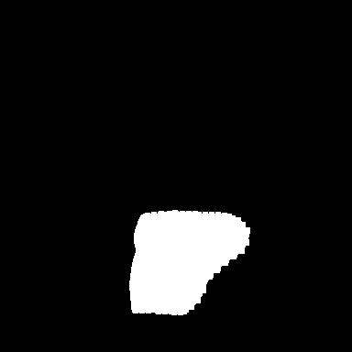
Research Procedure
Image Segmentation
If an image is given. The detection is to frame the object out, and the image segmentation separates the exact contour of an object. Also consider this, give an image I, the problem is to find a function, mapping from I to Mask. There are many ways to find this function. We can see this picture, the image is given on the left, the tibia bone can be seen, and the result is segmented on the right.

Slide 10
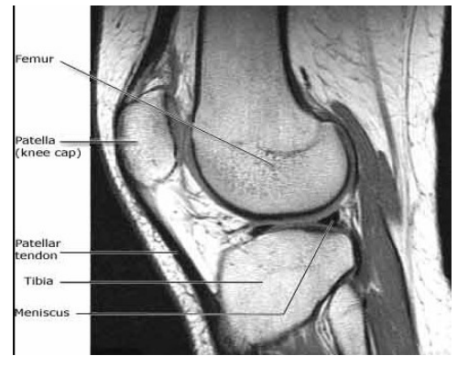
Research Procedure
Figure 2. Femur and tibia bones in a knee joint

Slide 11
2
Data Labeling

Slide 12
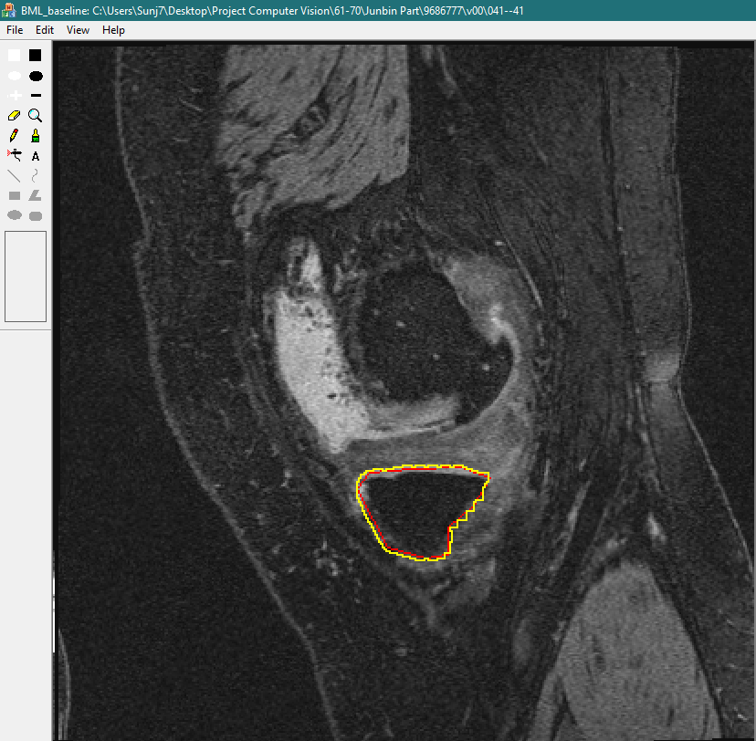
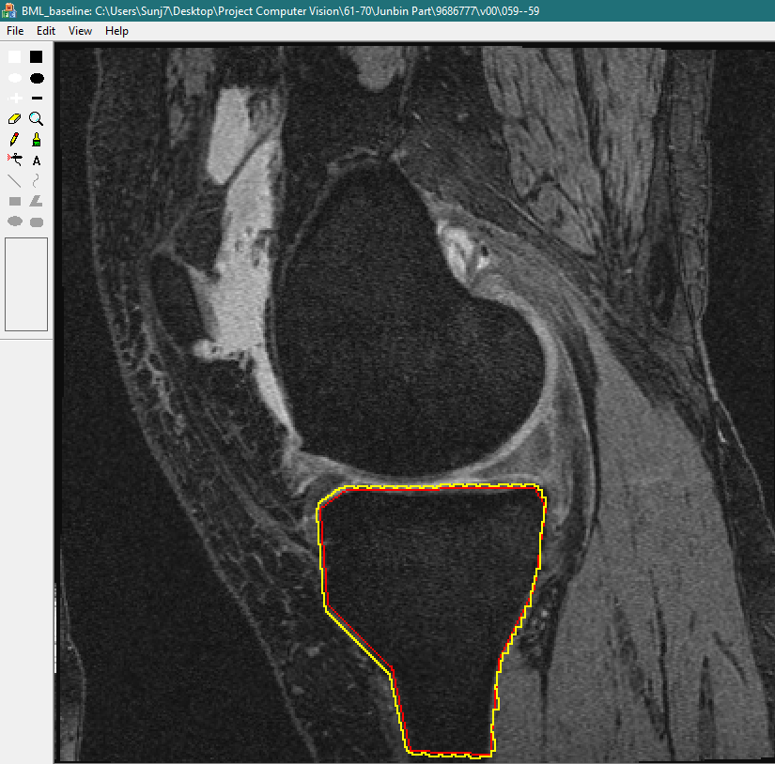
Data Labeling
STEP A: Using BML-Baseline Software
BML-Baseline
Wentworth Institute of Technology, Professor Ming Zhang , Software for Bone segmentation\source (code\Tibia\)
STEP B: Label the Tibia Bone
STEP C: Manual Segmentation

Slide 13
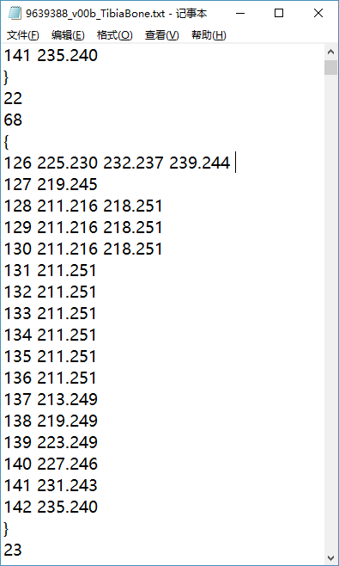
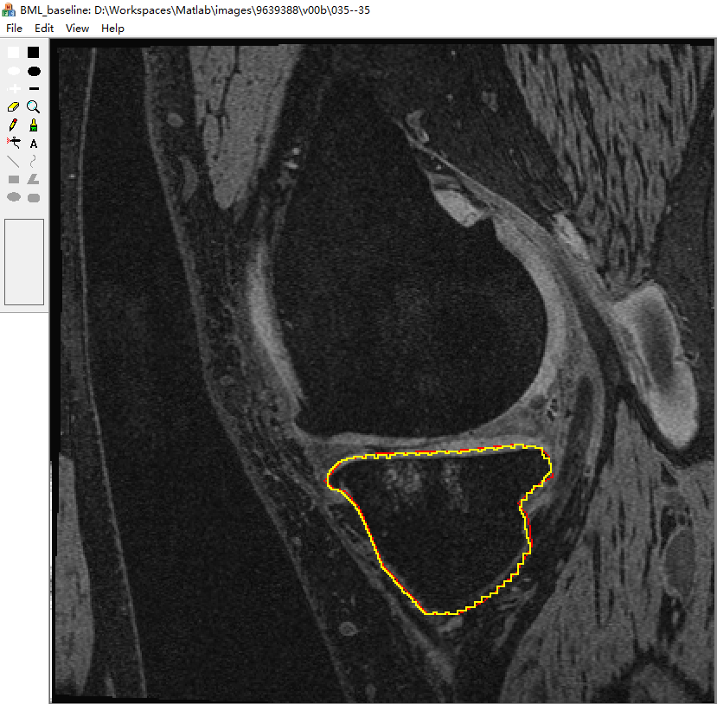
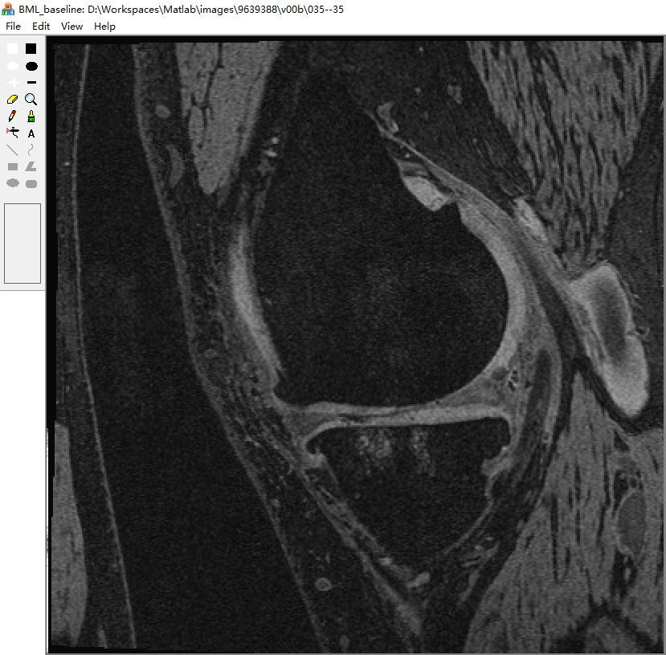
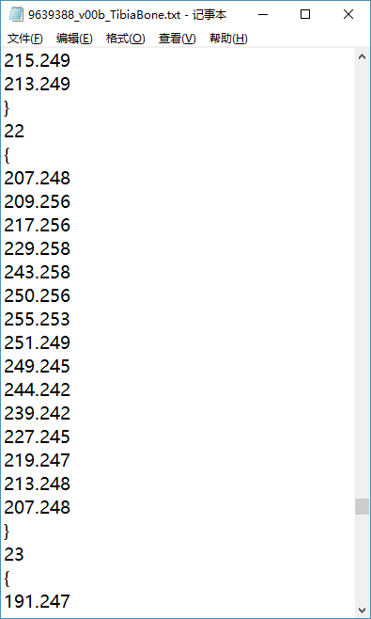
Data Labeling
Try to repair unsatisfied labeling
1. Double Click on image
2. Change the txt file
yellow
line
red
line

Slide 14
3
Data Preparation

Slide 15
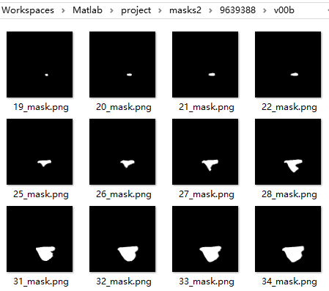
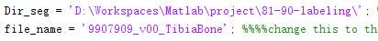
Data preparation
Generate binary masks from txt files
Modify and run Bone_Onefolder_edit2.m
1. For data.py, change mask image name to ‘_mask.png’
2. For every case or txt file, change folder and file name

Slide 16
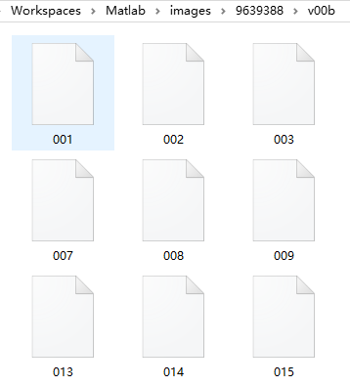
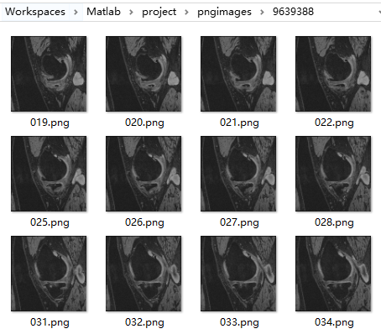
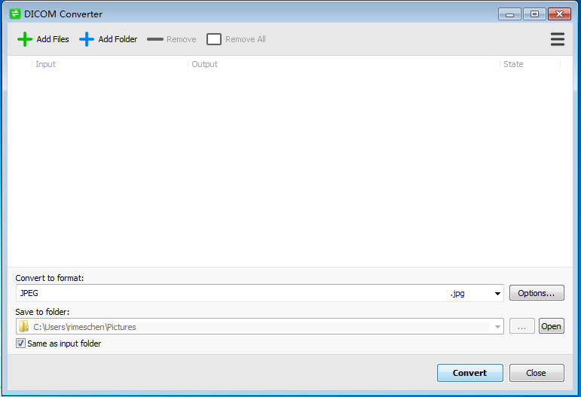
Data preparation
Convert all DICOM images into PNG format
Delete images which do not have corresponding mask.
Download DICOM Converter to convert image format

Slide 17
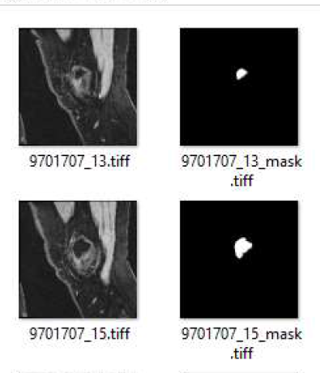
Data preparation
Change name of images for data.py
19_mask.png → 9639388_19_mask.png

Slide 18
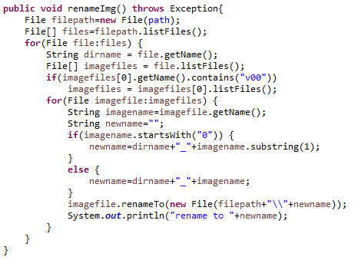
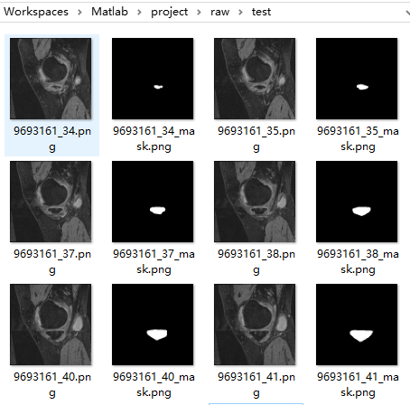
Data preparation
Change the file name
Use the Java code, and prefix all images, masks

Slide 19
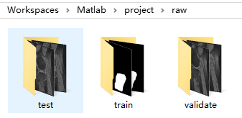
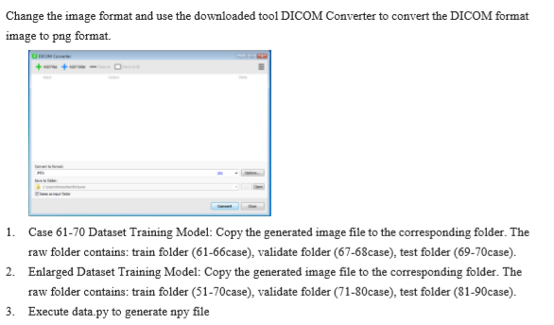
Data preparation
Create images for data.py
Assign Training Set Cases
6-2-2， enlarge 20-10-10

Slide 20
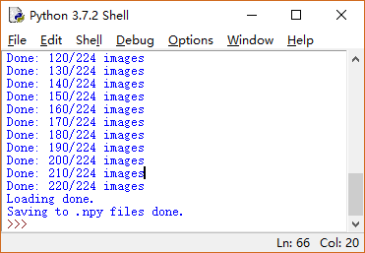
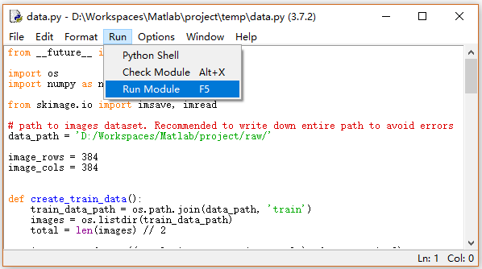
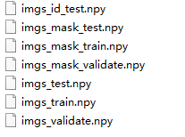
Data preparation
Get npy files by running data.py

Slide 21
4
Model Training and Testing

Slide 22
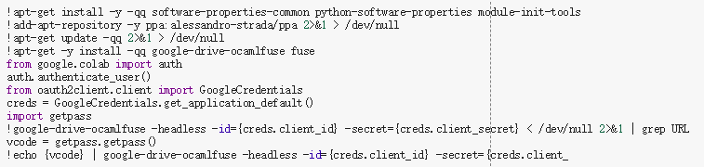
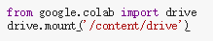
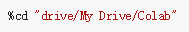
Model Training
Prepare Colab
Mount google drive, change to working directory

Slide 23
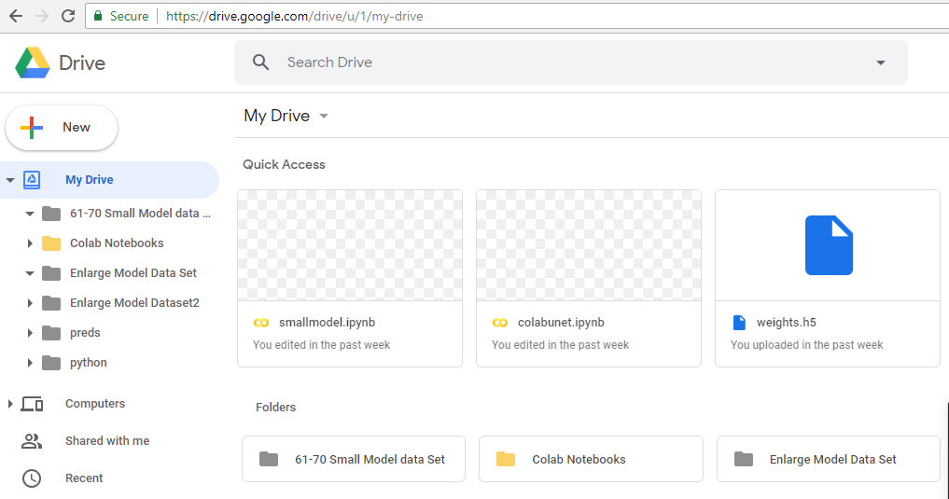
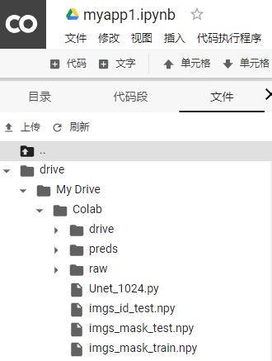
Model Training
Prepare Colab
Upload npy files, data.py, and Unet_1024.py to google drive

Slide 24
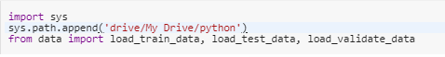
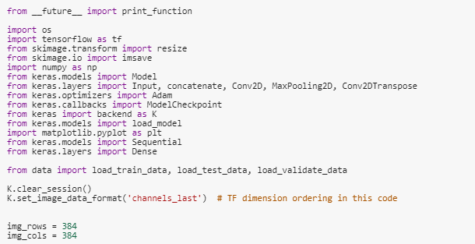
Model Training
Modify code and run.
Load Data
Training is an optimization.
The architecture used in this code is keras.
Now tensorflow contains the keras architecture.
Img_rows Img_cols size of the image.

Slide 25
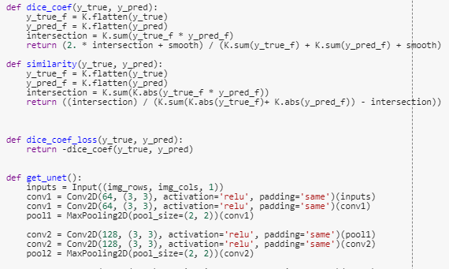
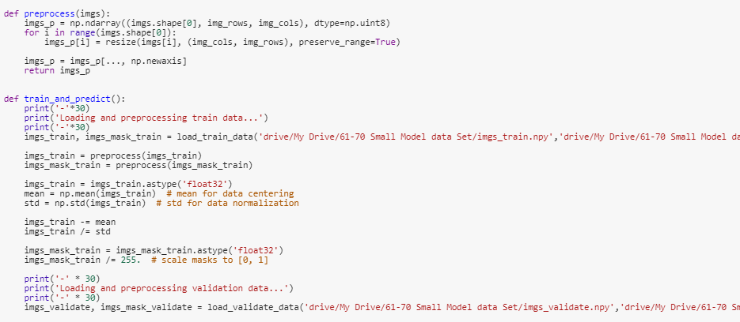
Model Training
Modify code
Dice function and Unet network.
Image process and prediction.

Slide 26
Model Training
Modify code
Dice function and Unet network.
Image process and prediction.(load_train_data change as parameter)

Slide 27
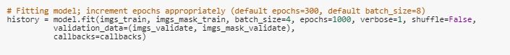
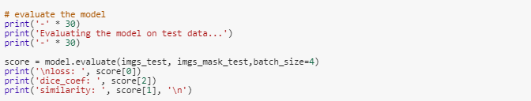
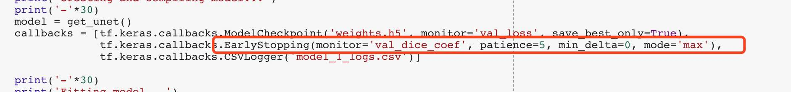
Model Training
Modify code
Fitting model, we put the trainning set into the model with batch_size 4 ( Orginally set as 8 GPU overload)

Slide 28
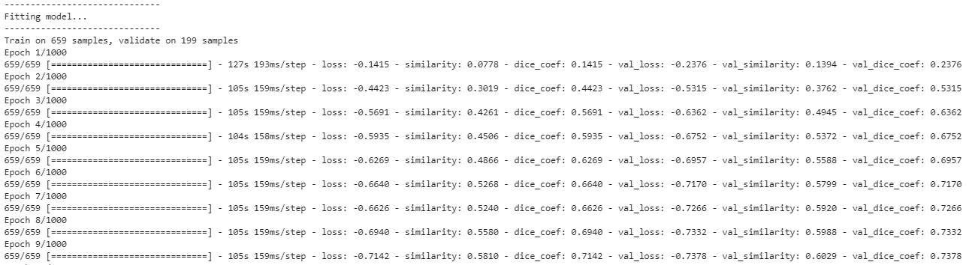
Model Training
Traning
Loss: The overall loss value.
Similarity: The comparison of the similarity. (Prediction)/(Reality) calculation.
Dice_coef: the loss value 0.1415.

Slide 29
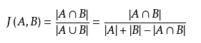
Model Training
Traning
The jaccard index, also known as the jaccard similarity coefficient, is used to compare similarities and differences between finite sample sets. definition:
Given two sets A, the B jaccard coefficient is defined as the ratio of the size of the intersection of A and B to the size of the union. The larger the jaccard value, the higher the similarity

Slide 30
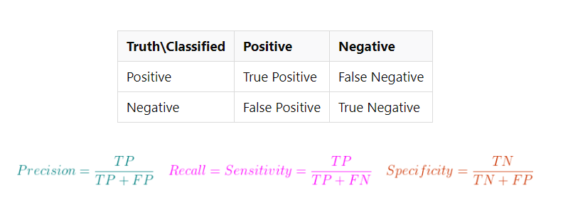
Model Training
Traning
There are Sensitivity and Specificity in statistics, and Machine Learning (Pattern Recognition) has Precision and Recall. Their relationship is as follows:

Slide 31
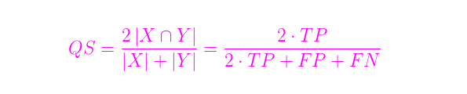
Model Training
Traning
Common expression of Sørensen–Dice coefficient:
QS is the Quotient of Similarity, the value of the coefficient, which is only between 0 and 1.
In Image Segmentation, the mask split by the model is the total number of images selected, and the mask marked by the expert is the correct total. Corresponding to the formula, the total number of choices (TP+FP) and the correct total number (TP+FN) are X and Y respectively, and the intersection is TP.
The higher the coefficient, the higher the similarity between the segmentation result and the standard answer, and the model is that it is more feasible to use.

Slide 32
Model Training
Traning
The evaluation for segmentation accuracy commonly hires DICE coefficient and similarity.
DICE_COEF = (2 * sum(g_truth .* predict) + 0.00001) /
(sum(g_truth) + sum(predict) + 0.00001)
SIM = sum(abs(g_truth .* predict)) /
(sum(abs(g_truth) + abs(predict)) - sum(abs(g_truth .* predict)))
(g_truth : ground truth matrix
predict : detection matrix from detector)

Slide 33
Result
Experiment Result ( Accuracy Evaluation on Test, Validate, Train Samples)
 | 10 cases data-set 61-70(6 2 2) | Enlarge data-set( 40 cases)
Sample count (train / valid / test) | 659 / 119 / 224 | 2155 / 1130 /1090
Epochs until completed | 44 / 100 | 30 / 100
Training time | 57 min | 2 hours
Accuracy for Test samples | loss: -0.8974272337343011 dice_coef: 0.8974272337343011 similarity: 0.8210569231637886 | loss: -0.8916647493292432 dice_coef: 0.8916647493292432 similarity: 0.8148831796208653
Accuracy for Validate samples | val_loss: -0.8677 val_dice_coef: 0.8677 val_similarity: 0.7847 | val_loss: -0.8680 val_dice_coef: 0.8680 val_similarity: 0.7782
Accuracy for Train samples | loss: -0.9415 dice_coef: 0.9415 similarity: 0.8906 | loss: -0.9439 dice_coef: 0.9439 similarity: 0.8971

Slide 34
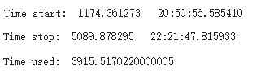
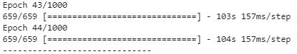
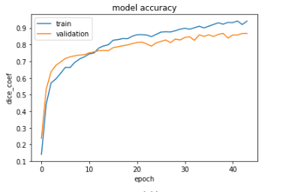
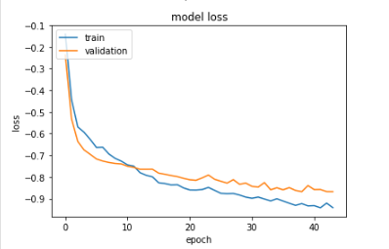
Result
10 cases data-set 61-70(6 2 2)
.

Slide 35
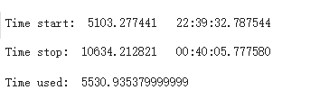
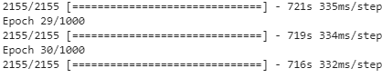
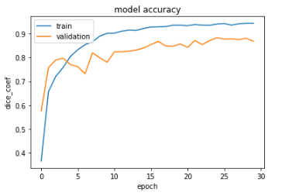
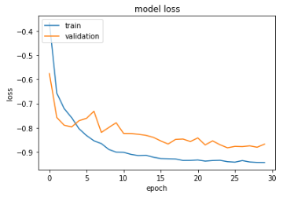
Result
Run in 40 cases, 20-10-10.

Slide 36
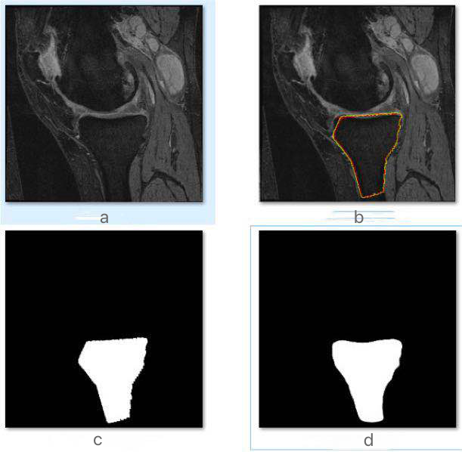
Result
c d
Figure 1. （a) Raw Image. (b) Manual Segmentation. (c) Mask Image Generated from Manual Segmentations. (d) Segmentation Result from U-net.
a
b

Slide 37
Conclusion
Conclusion
1) The model from large dataset gives nearly the same segmentation result than one form small dataset.
2) U-Net convolution network can give good segmentation result by training with even small amount of samples.
.

Slide 38
Reference
References
[1] https://en.wikipedia.org/wiki/U-Net
[2] https://lmb.informatik.uni-freiburg.de/people/ronneber/u-net/
[3] https://towardsdatascience.com/review-u-net-biomedical-image-segmentation-d02bf06ca760
[4] Cai, Jinzheng, et al. "Pancreas segmentation in MRI using graph-based decision fusion on convolutional neural networks." International Conference on Medical Image Computing and Computer-Assisted Intervention. Springer, Cham, 2017.
[5] Wang, Chengjia, et al. "A two-stage 3D Unet framework for multi-class segmentation on full resolution image." arXiv preprint arXiv:1804.04341 (2018).[6]
[6] Seoud, Lama, et al. "Training a CNN to robustly segment the human body parts in range image sequences." Optical Data Science II. Vol. 10937. International Society for Optics and Photonics, 2019.
.

Slide 39
2019
THANK YOU
Thanks to Professor Shan for teaching

